Slide 1


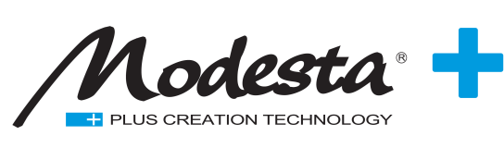
Join and ask questions at slido.com – event #:
#MODESTA

Slide 2
CHEMICAL BACKGROUND OF THE MODESTA RANGE

Slide 3
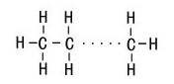


Energy of inorganic bonds VS organic
The Binding Energy of Si-O-Si is 25-60% stronger than C-C.
Si-O-Si binding energy = 106kcal/mol
Maximum UV energy (sunlight / 480nm) = 98kcal/mol
C-C binding energy = 82.6kcal/mol
Paraffin Wax

Slide 4
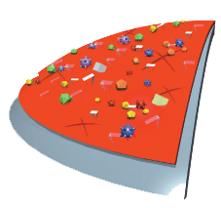
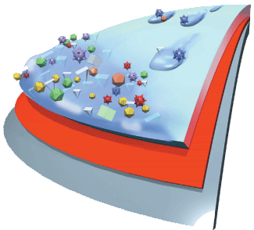
Modesta glass coating layer
Protected surface
Contaminations can’t deposit into the paint and cause damages.
Unprotected surface
Contaminations deposit into the paint and cause damages by friction, oxidation and other means.

Slide 5
Modesta BC-06 chemical reaction
Gas
→
(SiH₂NH) + 2H₂O
Perhydropolysilazane 2x Water
(SiO₂) + NH₃ + 2H₂
Silicon Dioxide Ammonia Hydrogen

Slide 6
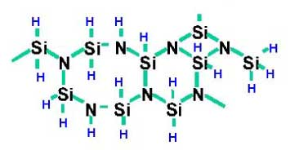
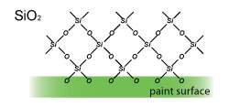
Modesta BC-06 chemical reaction
Silicon, Si
Hydrogen
Oxygen
+
H2O
Hydrolyze
Nitrogen

Slide 7
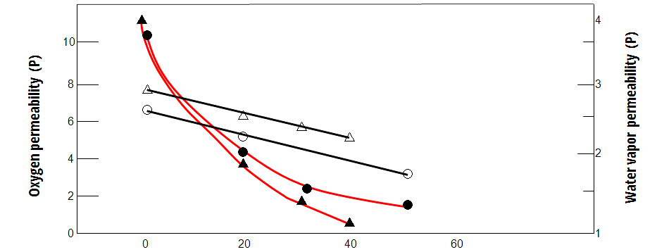
Organic and Inorganic Composite
Oxygen & Water
Vapor Permeability
Oxygen permeability:
○ - Water base
△ - Solvent base
Water vapor permeability:
● - Water base
▲ - Solvent base
The amount of silica contained in the coating (wt %)

Slide 8
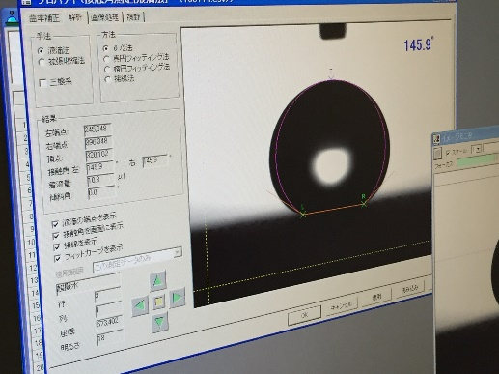
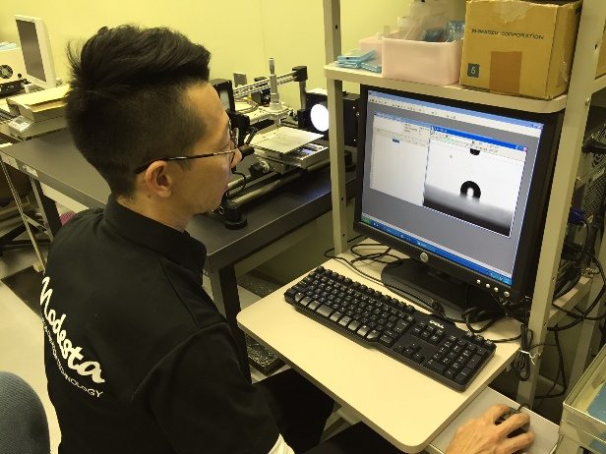
Water repellency
When a molecule of a liquid is in contact with another phase, its behavior depends on the relative attractive strengths of its neighbors on the two sides of the phase boundary. If the molecule is more strongly attracted to its own kind, then interfacial tension will act to minimize the area of contact by increasing the curvature of the surface. This is what happens at the interface between water and a hydrophobic surface such as a plastic mixing bowl or a windshield coated with oily material.

Slide 9

Measuring contact angles

Slide 10
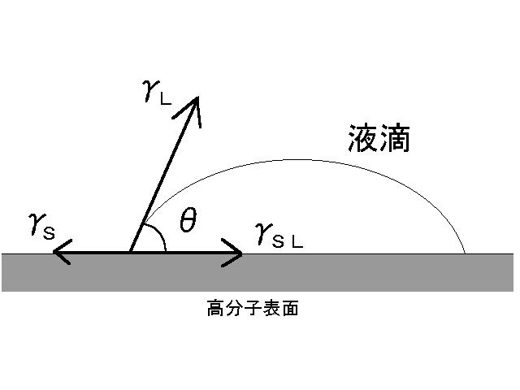
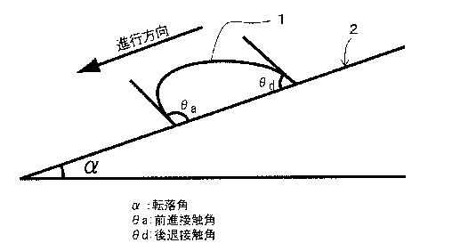
Water repellency
Receding C Angle
Static C Angle
Young–Laplace equation
Dynamic contact angle

Slide 11
Water repellency
 | Water |  |  | n-Hexadecane
 | Static C Angle | Receding C Angle | Sliding Angle | Static C Angle | Receding C Angle | Sliding Angle
Other Product | 117 | 101 | 42 | 70 | 66 | 25
PD | 115 | 110 | 20 | 67 | 65 | 10

Slide 12
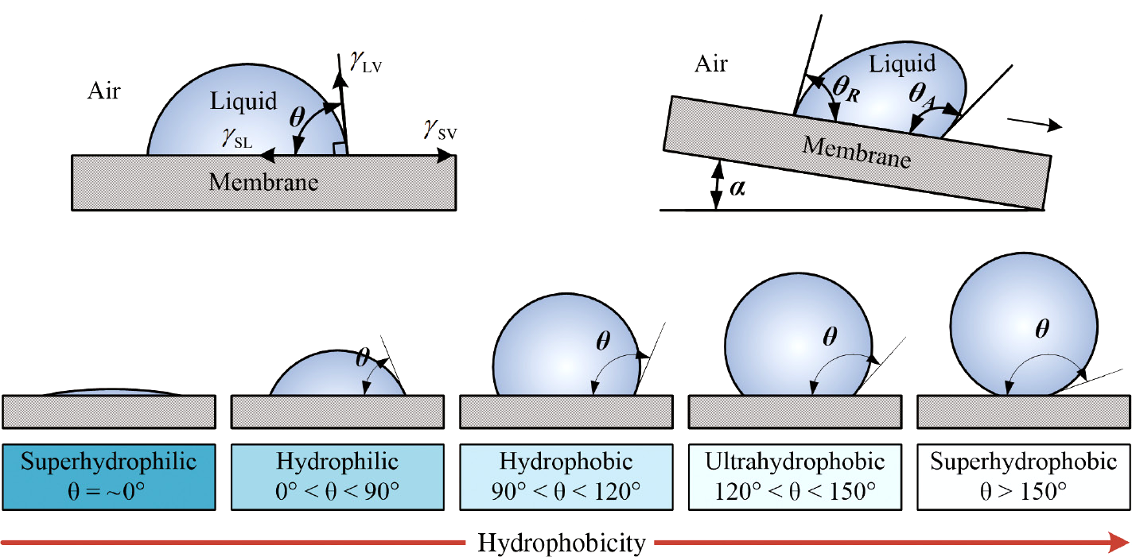
Water repellency
In a measurement of the static contact angle
with n-hexadecane, oil repellency is if the
result is lower than 50° contact angle.
The smaller sliding angle the better.
The difference between a receding contact
angle and a static contact angle is the smaller
the better.

Slide 13
Water Contact Angle
Water contact angle (in °) |  | Coating
 |  | Contact Angle | Name | Form
180° 20° | Super Hydrophobic ≥ 150° | ≥ 150° | - | Fractal
 | Hydrophobic ≥ 90° | 115° | PD | Fluorine
 |  | 110° | BC-05 | Flat
 |  | 100° | BC-01
 |  | 90° | BC-02
 | Hydrophilic < 90° | 80° | BC-08
 |  | 70° | BC-04
 |  | 70° | BC-03
 |  | 40° | BC-09
 |  | 20° | BC-06

Slide 14
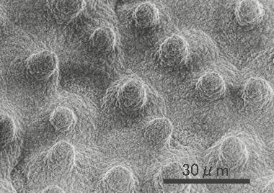
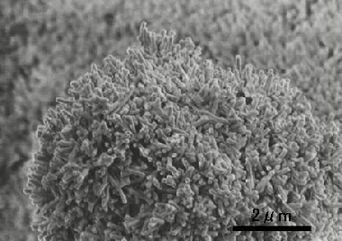
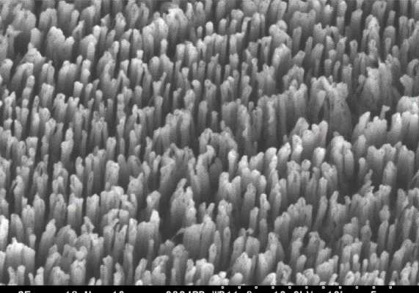
Water Contact Angle
Lotus leaf
Scanning Electron Microscope / 1,000 x
Lotus leaf
Scanning Electron Microscope / 13,000 x
Artificial nano columnar structure

Slide 15
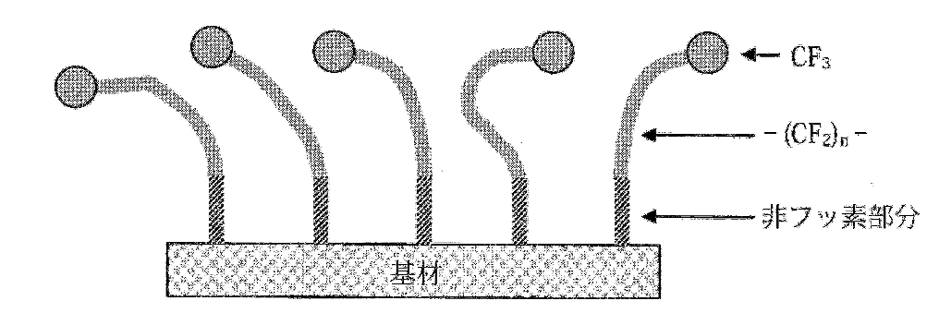
Water Contact Angle
Fluorine Compound

Slide 16
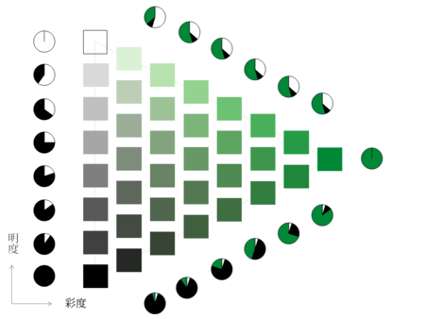
Effect of Color on Glossiness
Although there are numerous methods for measuring the glossiness instead of the psychological glossiness, the glossiness obtained by these methods do not agree with the psychological glossiness when the specimen's color changes.
An Investigation of Effect of Color on Glossiness by Seiichi Serikawa and Teruo Shimomura, both members of Kyushu Institute of Technology, proved that psychological glossiness is decreased when brightness(value) gets higher, and psychological glossiness is increased when chroma get higher.

Slide 17
Modesta product range
 | BC-03 | BC-04 | BC-05 | BC-06 | BC-08 | PD
Coating film thickness | 2.0 - 3.0µm | 2.0 - 4.0µm | 3.0 - 5.0µm | Approx. 0.2µm | 0.2 - 2.0µm | 3.0 - 7.0µm
Heat resistance | 700 °C | 900 °C | 1,000 °C | 1,300 °C | - | 1,000 °C
Durability | 3 -10 years | 3 -10 years | 3 -10 years | 3 -10 years | 1 -2 years | 3 -10 years
Gloss | candy-like gloss | candy-like gloss | candy-like gloss | natural radiance | candy-like gloss | candy-like gloss
Contact angle | 50 – 70 | 50 – 70 | 110≦ | 10 – 20 | 80 | 115≦

Slide 18
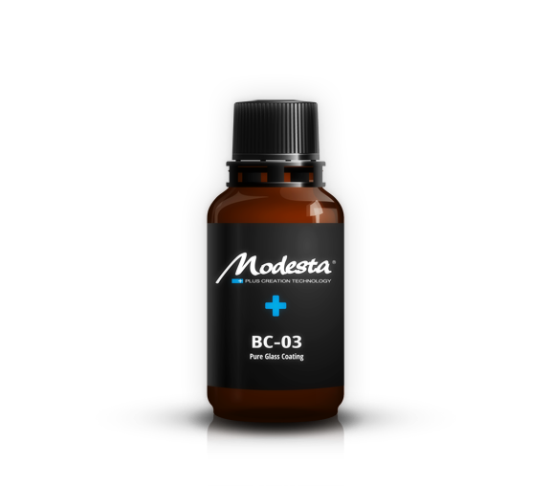
BC-03 Pure Glass Coating
Eliminating the risk of scratches is not the only consideration in protecting motor vehicle paint. The major cause of paint damage types such as loss of gloss and dullness is paint oxidization, which can be slowed by isolating the surface from the air. Although this can be achieved with conventional coating agents and wax, the oil and fat contained in such materials oxidize easily, and in turn oxidize anything they come into contact with. As a result, these paint protection methods can actually accelerate the deterioration of paint rather than retarding it. The inorganic nature of glass coating makes it resistant to oxidization and therefore more suitable for protecting paint. The hard physical barrier it creates also prevents paint from coming into contact with the air. Modesta BC-03 does not crack, bubble, flake, peel, delaminate, detach or discolor at temperatures below 700°C.

Slide 19

BC-04 Nano-Titanium Glass Coating
A new formula coating that combines the best advantages of the original Pure Liquid Glass coatings and highest quality nano grade titanium. This combination creates a deeper shine and better reflections on the paint. A significantly prolonged working time also allows easier and safer application. The inorganic nature of the coating makes it fully resistant to oxidation. The hard physical barrier it creates also prevents paint from coming into contact with air and acts as a anti-scratch protectant. Modesta BC-04 is capable to withstand temperatures of up to 900 °C.

Slide 20
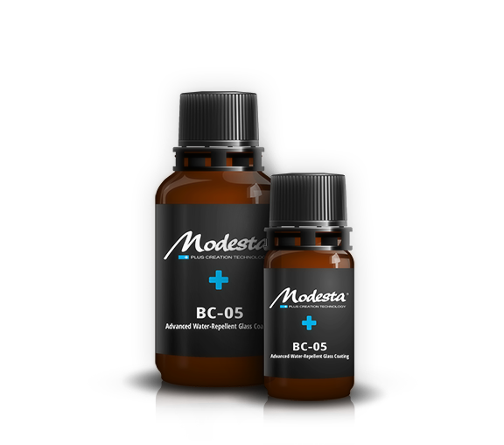
BC-05 Advanced Water-repellent Glass Coating
Modesta BC-05 is a glass coating based on a three-dimensional siloxane frame, and forms a highly durable clear membrane. The core technology was originally developed in the manufacturing industry for application to molds to facilitate the release of products from molds, and its strong anti-fouling property can even repel permanent marker ink. The coating also reduces drag by 5 km/h compared to regular paint at speeds over 60 km/h (drag coefficient: -0.02), and demonstrates strong water-repelling qualities. It can be applied even to the most advanced and sophisticated paints, such as Nissan Scratch Shield, Lexus’ self-restoring coat and Mercedes ceramic paint.

Slide 21
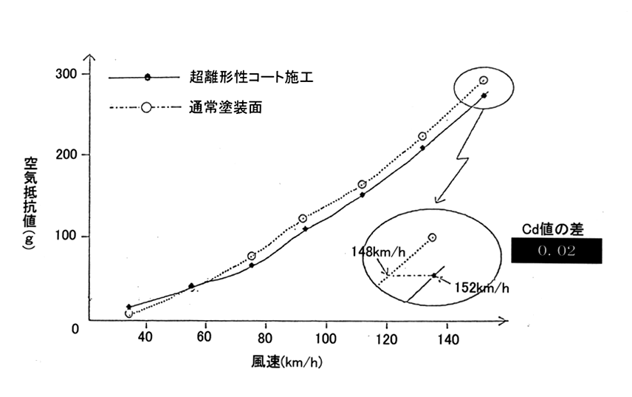
BC-05 Advanced Water-repellent Glass Coating
Wind-tunnel experiment

Slide 22
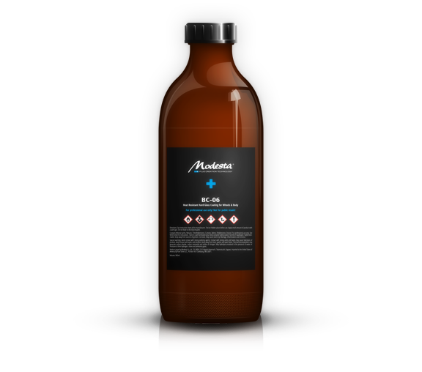
BC-06 Heat Resistant Glass Coating for Wheels & Body
Modesta BC-05 is a glass coating based on a three-dimensional siloxane frame, and forms a highly durable clear membrane. The core technology was originally developed in the manufacturing industry for application to molds to facilitate the release of products from molds, and its strong anti-fouling property can even repel permanent marker ink. The coating also reduces drag by 5 km/h compared to regular paint at speeds over 60 km/h (drag coefficient: -0.02), and demonstrates strong water-repelling qualities. It can be applied even to the most advanced and sophisticated paints, such as Nissan Scratch Shield, Lexus’ self-restoring coat and Mercedes ceramic paint.

Slide 23
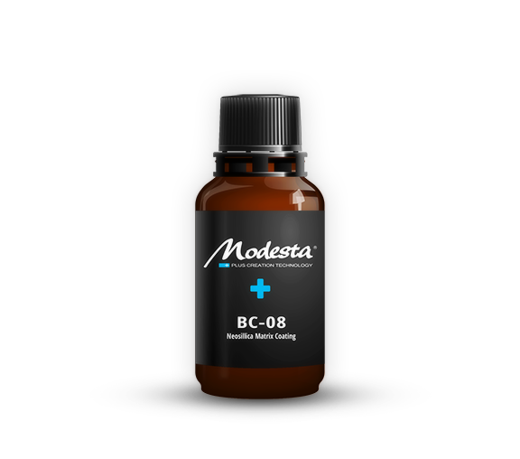
BC-08 Neosillica Matrix Coating
An easy coating for quick application on daily driven vehicles. Traces of zirconium create great shine and luster on the paint while it’s three dimentional matrix ensures excellent water repellency and self cleaning. The coating’s thick layer acts as a self scarifying barrier to protect the finish of the vehicle from scratches and marring as well as adverse environmental effects.

Slide 24
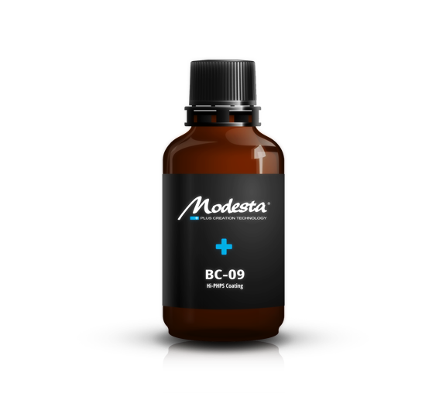
BC-09 Hi-PHPS Coating
Based on BC-09 this product is a highly concentrated Per-Hydro-Polysilazane (PHPS) coating especially designed to allow application by conventional wipe on. BC-09 creates a highly durable hydrophilic layer of special polysilazane molecules that can protect the paint from contamination and dirt and deliver a improved scratch resistance. This coating will keep your car clean for a long time and will prevent impurities from sticking to it’s surface. Modesta BC-09 is capable to withstand temperatures of up to 1300 °C.

Slide 25
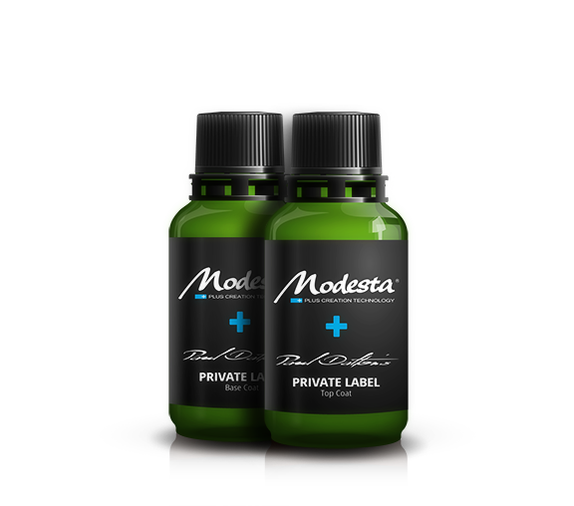
PD Private Label
This unique set of two components - a Base Coat and a Top Coat provides the ultimate protection to the paint of your vehicle. The rigid, hard Base Coat acts as a strong wear and tear protection, effective against scratches and mechanical damage. It will cure into a crystal clear layer of pure inorganic silica. The super-hydrophobic Top Coat provides a state of the art water behavior with excellent self cleaning properties. The combination of these two components make the resulting coating layer extremely resistant to all kinds of chemical agents.
A thick layer of the Base Coat, combined with the P-01A Primer and the Top Coat provide a very special and intense "candy-like gloss" effect and breath-taking deep reflections on the paint of the vehicle. The combination will also boost saturation and color intensity of every paint.

Slide 26
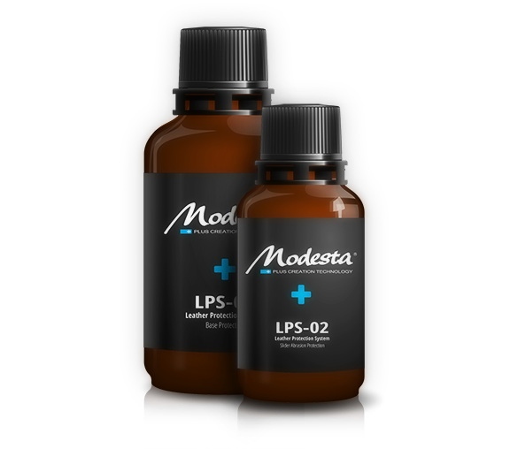
LPS Leather Protection System
The Modesta Leather Protection System delivers exceptional protection to all leather and leather like surfaces in interiors of motor vehicles. This two component system is the only in the market that protects the precious surfaces from both - penetration by liquids and dirt as well as abrasion.
The Base Protection stops liquids from penetrating into the surface, reduces color transfer and makes cleaning of the surface easier with less chemicals required. This ensures longer durability of the surfaces and thus preserves the value of the vehicle.
The Slider Abrasion Protection is a unique top coat designed especially for Modesta's Leather Protection System. It reduces surface friction on exposed parts of interiors (for example seat bolsters). Due to the reduced surface friction the exposed parts will last longer without showing signs of the usual wear and tear.

Slide 27
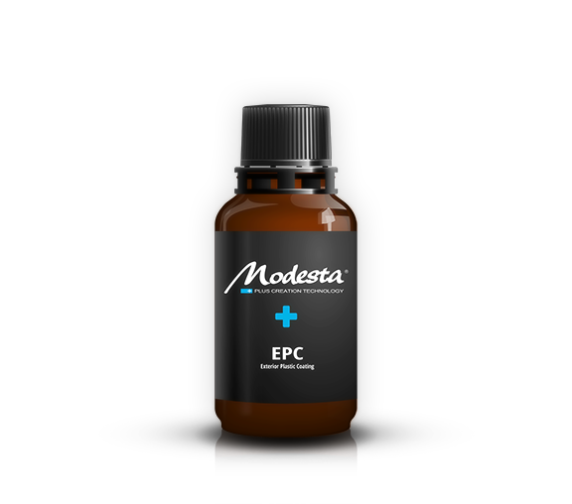
EPC Exterior Plastic Coating
The Modesta Exterior Plastic Coating is a unique blend of ingredients restoring uncoated exterior plastic parts of automobiles and other vehicles, by adding saturation and color depth. On weathered plastic parts with faded color, it will restore the original look and feel of the surface. At the same time, it will add protection against UV radiation and oxidation, thus prolonging the longevity of the material.
The EPC is a state-of-the-art solution to protect the factory new plastic parts of vehicles as well, as it will not significantly modify the looks and feel of the plastic, while providing long term protection to them.

Slide 28
EPC Exterior Plastic Coating
The Modesta Exterior Plastic Coating is a unique blend of ingredients restoring uncoated exterior plastic parts of automobiles and other vehicles, by adding saturation and color depth. On weathered plastic parts with faded color, it will restore the original look and feel of the surface. At the same time, it will add protection against UV radiation and oxidation, thus prolonging the longevity of the material.
The EPC is a state-of-the-art solution to protect the factory new plastic parts of vehicles as well, as it will not significantly modify the looks and feel of the plastic, while providing long term protection to them.

Slide 29
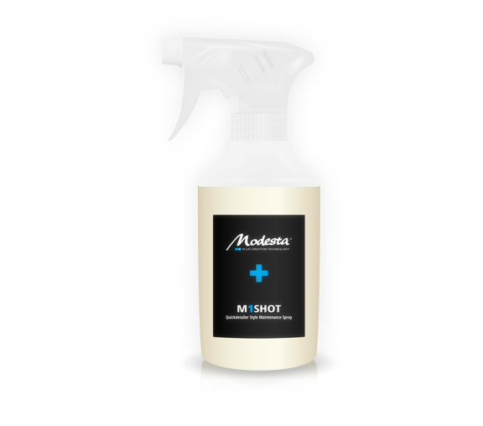
M1 SHOT Quickdetailer Style Maintenance Spray
Useful as a temporary protectant until glass coatings are fully cured. M-1 SHOT can also be used as a maintenance for Modesta's glass coatings that last long years, but the water repellent effect on their surface may degrade over time. M-1 Shot helps to recover this effect.
Organic composition containing carnauba wax
Provides the inorganic glass coating with a smooth and slick finish
It is important to protect the coating during the initial period (even infrared curing does not provide the coating with resistance against harsh chemicals and mineral deposits during the first 3-6 weeks)

Slide 30
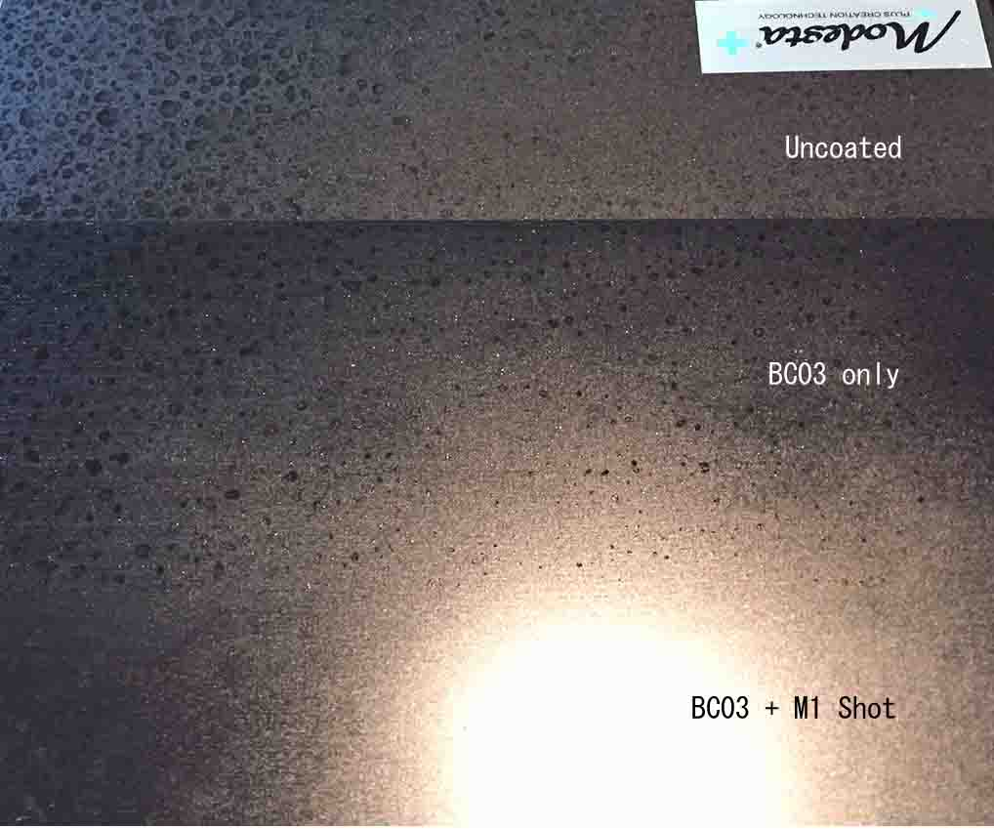
M1 SHOT Quickdetailer Style Maintenance Spray

Slide 31
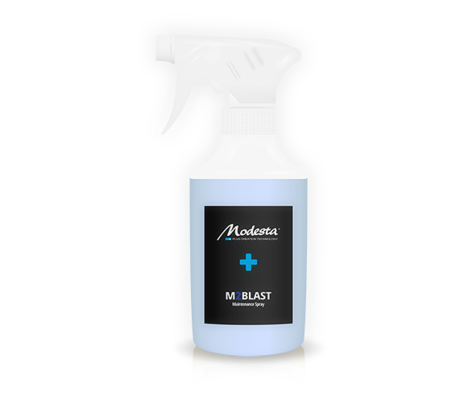
M2 BLAST Maintenance Spray
A quick and easy to use maintenance spray based on the Modesta M1SHOT, intended for frequent end customer usage. Easy to use under all conditions, easy wipe off with fewer streaks.
Key characteristics:
Designed for frequent usage reducing the risk of clogging up the coating structure
Easy application under all conditions
Reduced durability in comparison with M1

Slide 32
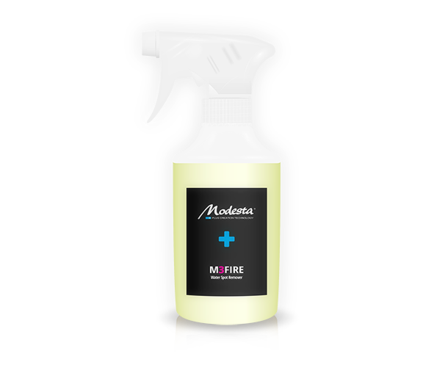
M3 FIRE Water Spot Remover
Highly effective, quick product to remove water spot issues from coated and non-coated surfaces in a regular maintenance scenario. Easy to use under all conditions, easy to wipe off with no residue and smearing and minimal product usage.
Key characteristics:
Easy wipe on & Wipe off
Easy application under all conditions
Smear free
Safe for Modesta coated surfaces
High yield – minimal amounts of product used

Slide 33
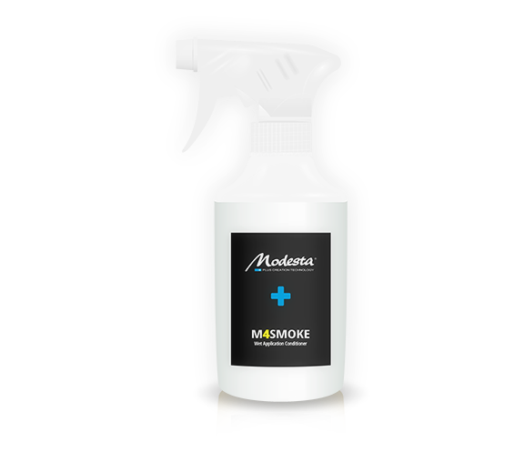
M4 SMOKE Wet Application Conditioner
Easy to apply regular day-to-day conditioner for coating maintenance.
Key characteristics:
Easy to use – Spray on during washing
Application to wet car – Wash off with pressure washer
Smear free
M4 Smoke is a special conditioner which removes dirt then restores/prolongs the coating’s original water repellency so it makes the surface looks brighter, shinier and recover water repellency. You can apply M4 Smoke after a car wash while the car is still wet, so you don't need to dry wipe the car twice.

Slide 34
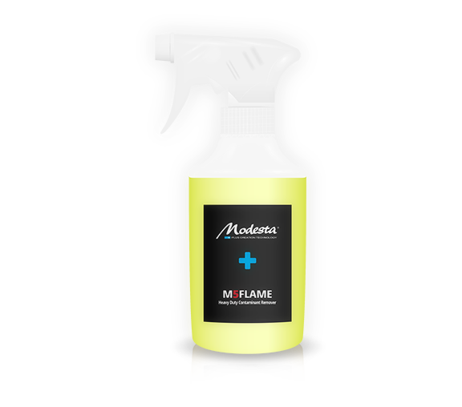
M5 FLAME Heavy Duty Contamination Remover
Highly concentrated liquid effective in removing heavy contaminants like water spots, tree sap, tar and many others from the surfaces of coated and non-coated vehicles. Quick and easy to use, wipe off without leaving and streaks or residue.
Key characteristics:
Last resort option to remove contaminants from paint and coated surfaces
Not for regular use
Safe for Modesta coatings – however lowering durability slightly
Slightly higher pH

Slide 35
M5 FLAME Heavy Duty Contamination Remover
Highly concentrated liquid effective in removing heavy contaminants like water spots, tree sap, tar and many others from the surfaces of coated and non-coated vehicles. Quick and easy to use, wipe off without leaving and streaks or residue.
Key characteristics:
Last resort option to remove contaminants from paint and coated surfaces
Not for regular use
Safe for Modesta coatings – however lowering durability slightly
Slightly higher pH

